Slide 1
U.S. TEEN BIRTH RATE
By : Lucy Thuku
: Virginia Mburu Brovont

Slide 2
Contents
Acknowledgement
About Me
Teen Birth Rate Definition
US Teen Birth Rate
Teen Birth Rate by State
Teen Birth Rate by Race
Summary
Conclusion

Slide 3


Acknowledgement
This project was inspired by our own personal challenges and is dedicated to our children Lucca Bashorun and Elvis Mburu.
Lucy and Virginia

Slide 4

About Me
LUCY THUKU
Born and raised in Kenya
Mother of a 4 year old boy – Lucca
Bachelors of Science in Computer Science
Experience in Technical and Systems Support for over 10 years
Interested in using data to draw meaningful conclusions and also be apart of the development of future technologies.

Slide 5

About Me
VIRGINIA MBURU BROVONT
Born and raised in Kenya.
Wife and Mother to a 19yr old boy – Elvis.
Patient Services Representative at Providence West Olympia Immediate Care.
Looking forward to being part of the women impacting the tech world.

Slide 6

Teen Birth
Definition
Teenage pregnancy(Teen Birth) is when a woman under 20 gets pregnant. It usually refers to teens between the ages of 15-19. But it can include girls as young as 10. It's also called teen birth pregnancy or adolescent pregnancy ¹ .
¹https://www.webmd.com/baby/teen-pregnancy-medical-risks-and-realities#:~:text=Teenage%20pregnancy%20is%20when%20a,have%20dropped%20steadily%20since%201990.

Slide 7
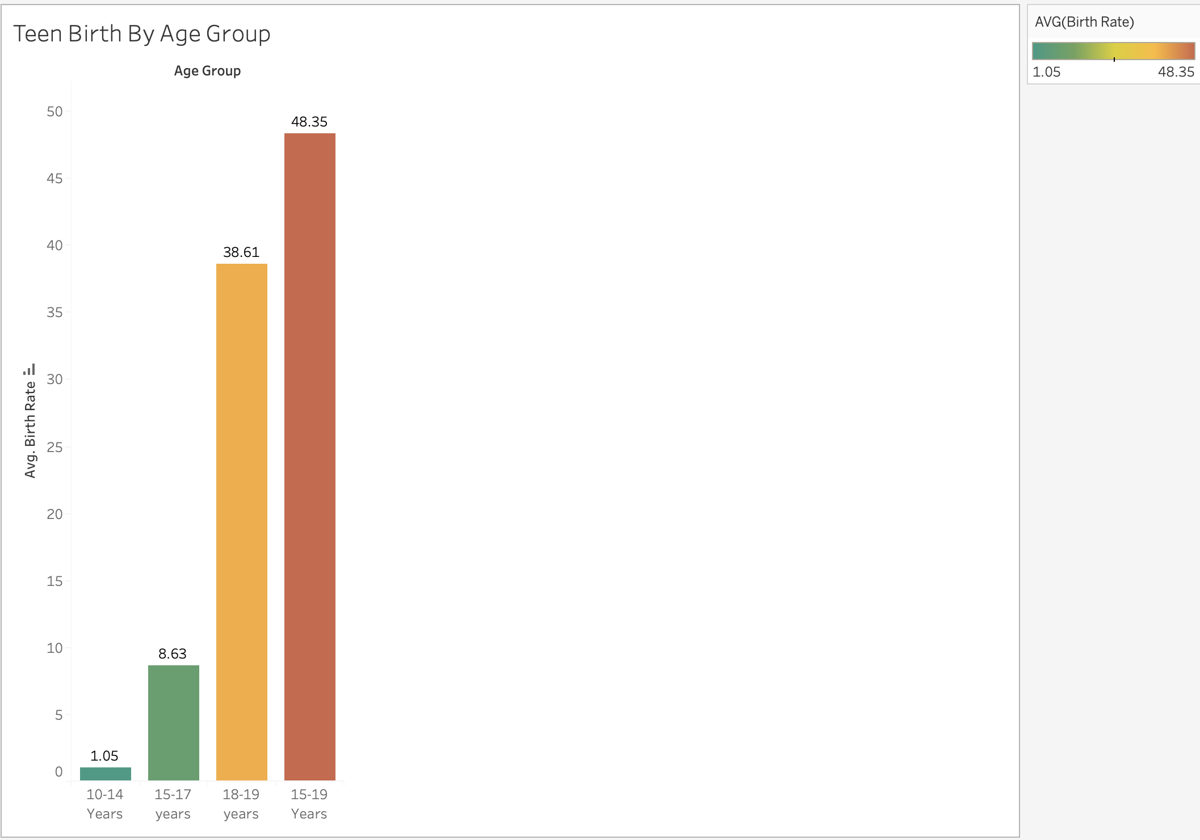
Teen Birth Rate
Definition
The teen birth rate measures the annual number of births to women 15 to 19 years of age per 1,000 women in that age group. It is also referred to as the age-specific fertility rate for women aged 15-19².
The teen birth rate is generally computed as a ratio. The numerator is the number of live births to women 15 to 19 years of age, and the denominator an estimate of the number of person-years lived by women at ages 15 to 19 during the same period of time. It is expressed as births per 1,000 women^{2.}
²https://www.un.org/en/development/desa/population/publications/dataset/fertility/adolescent-rate.asp

Slide 8
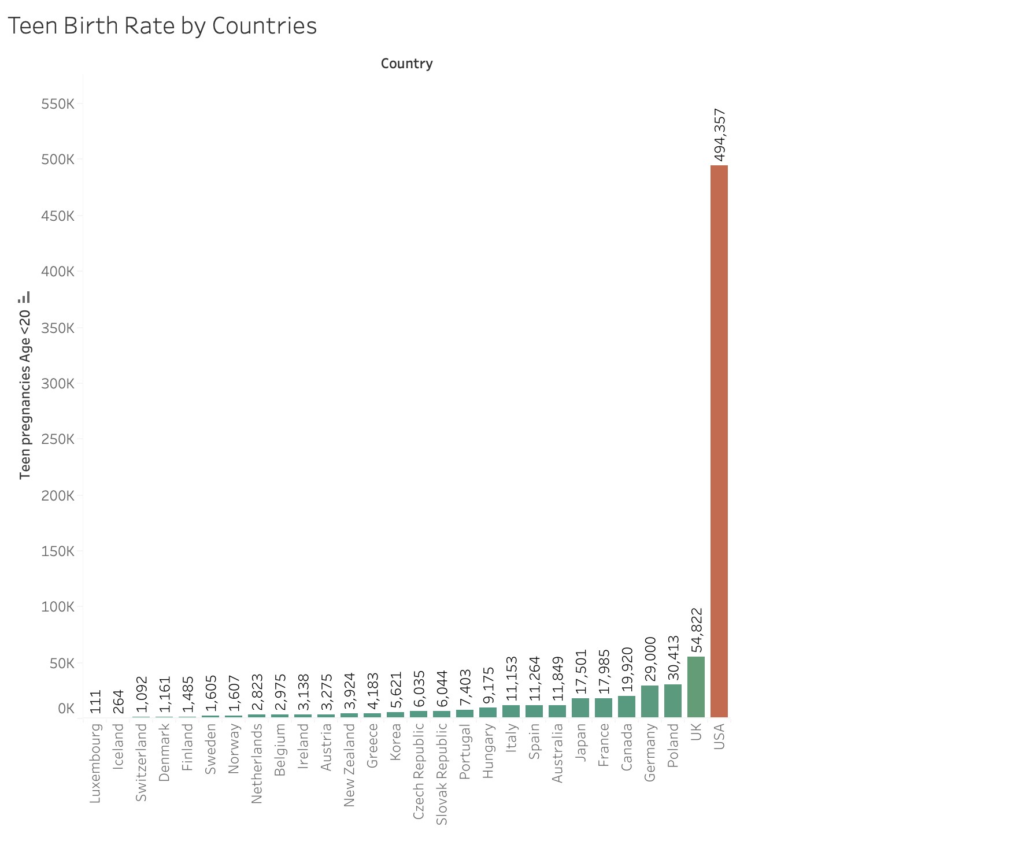
Teen Birth Rate by Rich Nations
“In the world’s rich nations, more than three quarters of a million teenagers will become mothers in the next twelve months.³”
³https://www.unicef-irc.org/publications/pdf/repcard3e.pdf

Slide 9
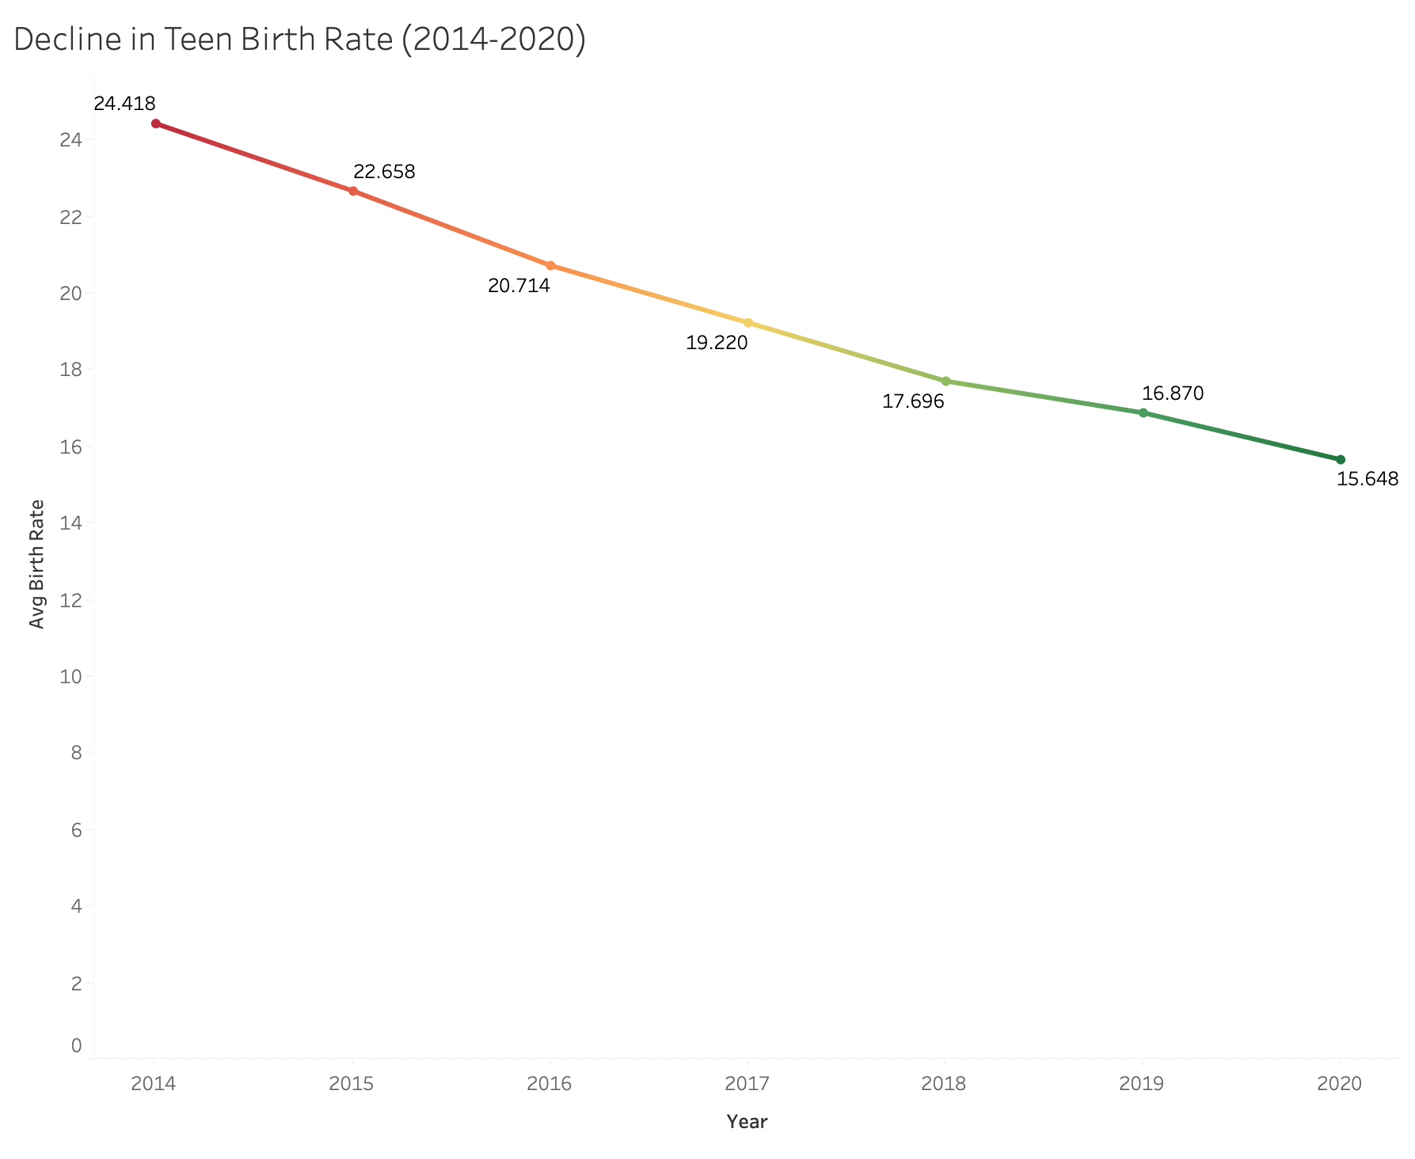
U.S. Teen Birth Rate
In the U.S., teen birth rates and number of births to teen mothers have dropped steadily since 1990⁴. Teen birth rates continued to decline from 24.42 per 1,000 females in 2014 to 15.648 per 1,000 females in 2020.
⁴https://www.un.org/en/development/desa/population/publications/dataset/fertility/adolescent-rate.asp

Slide 10
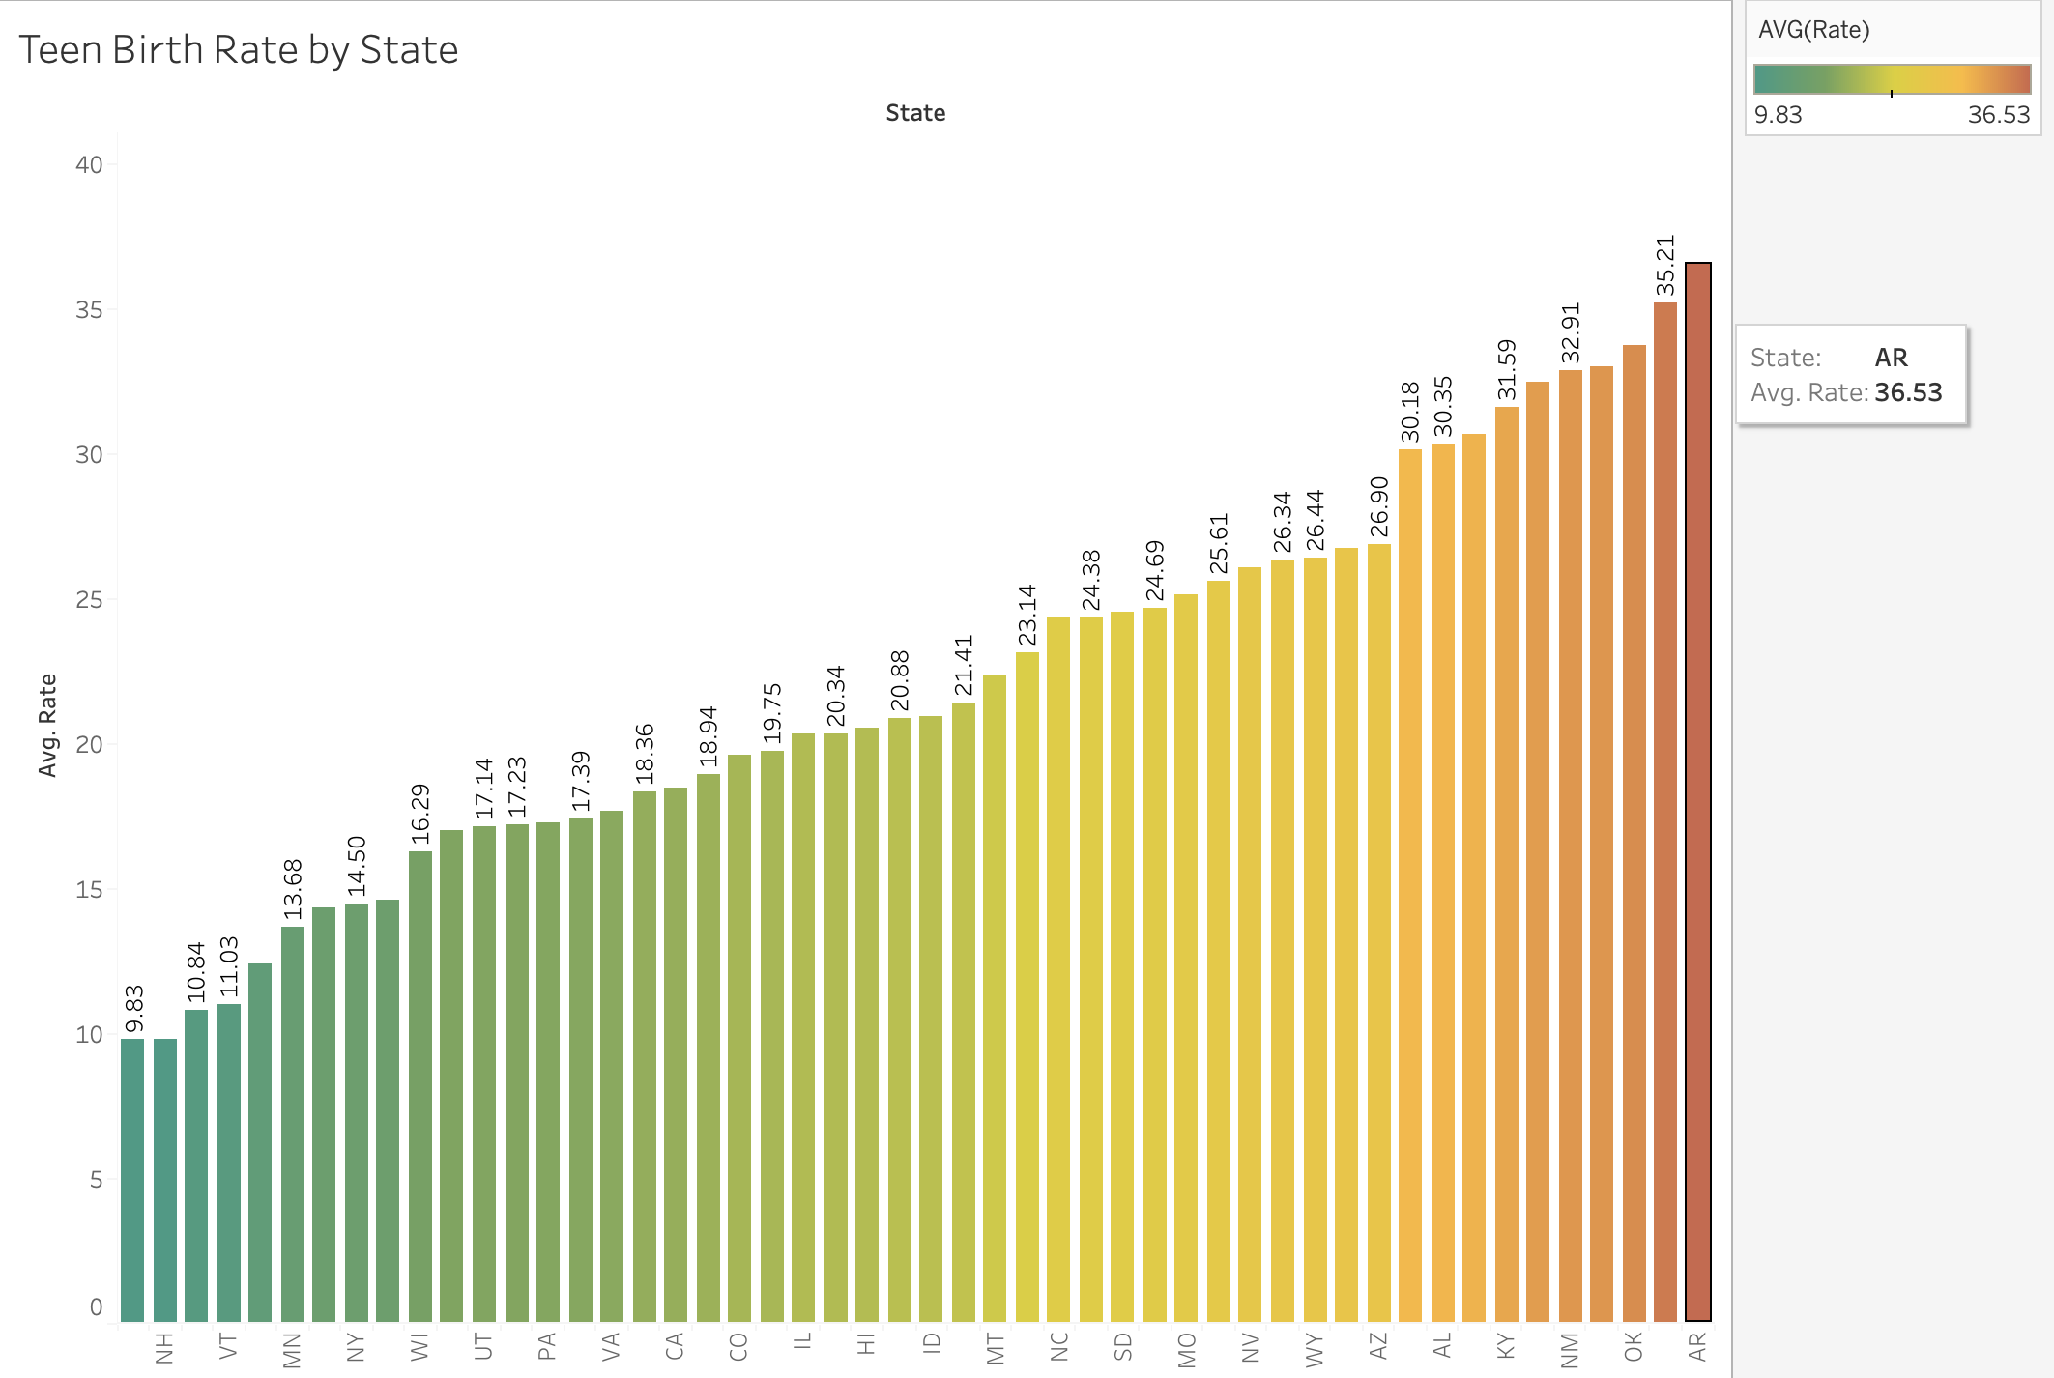
Teen Birth Rate By State
Geographic differences in teen birth rates persist, both within and across states. Although among states with low overall teen birth rates, some counties have high teen birth rates.
Disparities between US states show that Arkansas (36.53) has the highest numbers of mean teen births while Massachusetts (9.83) has the lowest.(data collected from 2014-2020)

Slide 11
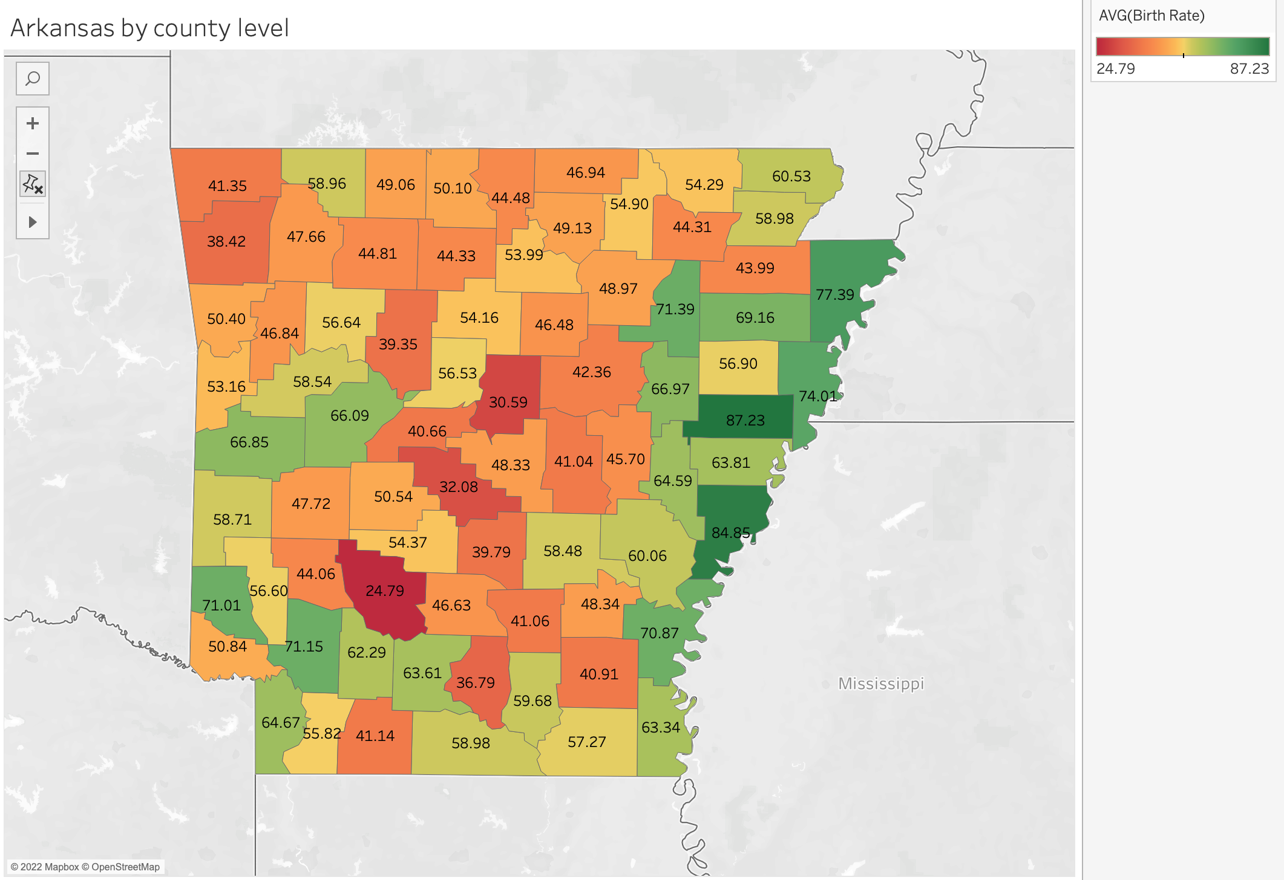
ARKANSAS
The number of teen births in Arkansas has slowly declined throughout the past 6 years. Even so, Arkansas continues to have the highest teen birth rate in the United States. For the past six consecutive years, Arkansas has come in last place — 50th out of the 50 states. The teen birth rate in Arkansas was 36.53 per 1,000 females ages 15-19, almost double the national average of 17 per 1,000.
The county with the highest teen birth rate in Arkansas was St. Francis with a rate of 87.23 and Clark county at the bottom with a rate of 24.79

Slide 12
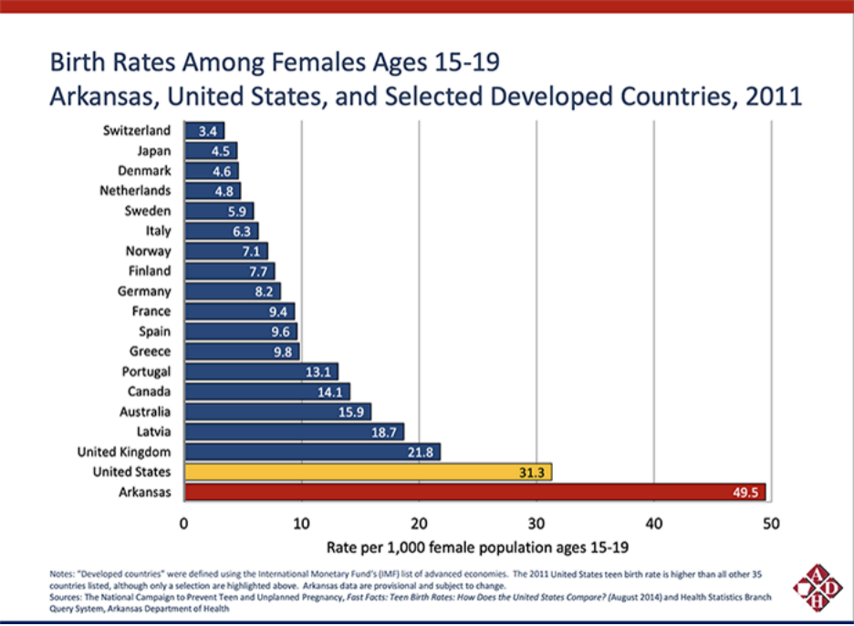
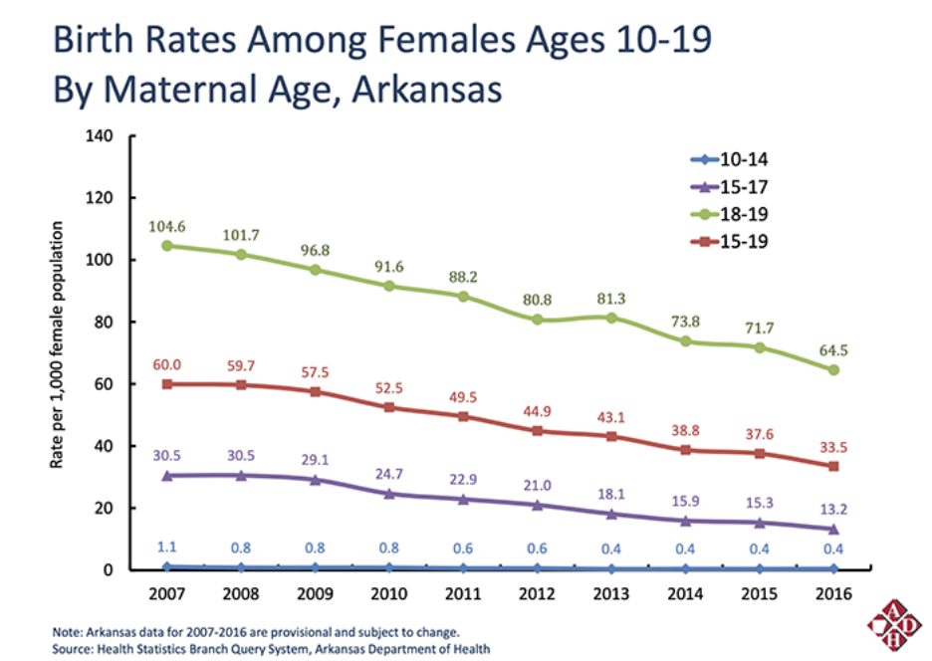

Slide 13
Factors contributing to high teen birth rates in Arkansas
Teen parent cycle.
Every year around 200 or more children in Arkansas age out without ever being adopted. Children become pregnant while in foster care often their kids end up in foster care as well.
Lack of sex education
Act 943 passed by the Arkansas legislature in 2015 requires higher education institutions in the state to develop and implement action plans to prevent unplanned pregnancy. That is a little too late because according to Arkansas Department of Health (ADH), nearly half of them will have already had sex and more than 34% will be “currently sexually active”
Limited access to contraception and family planning services
Arkansas is one of only few states in the country without some form of sexual education requirement. Focus is more on abstinence which evidence shows is not effective.
Source : https://www.aymag.com/cause-effect-teen-pregnancy-in-arkansas/

Slide 14
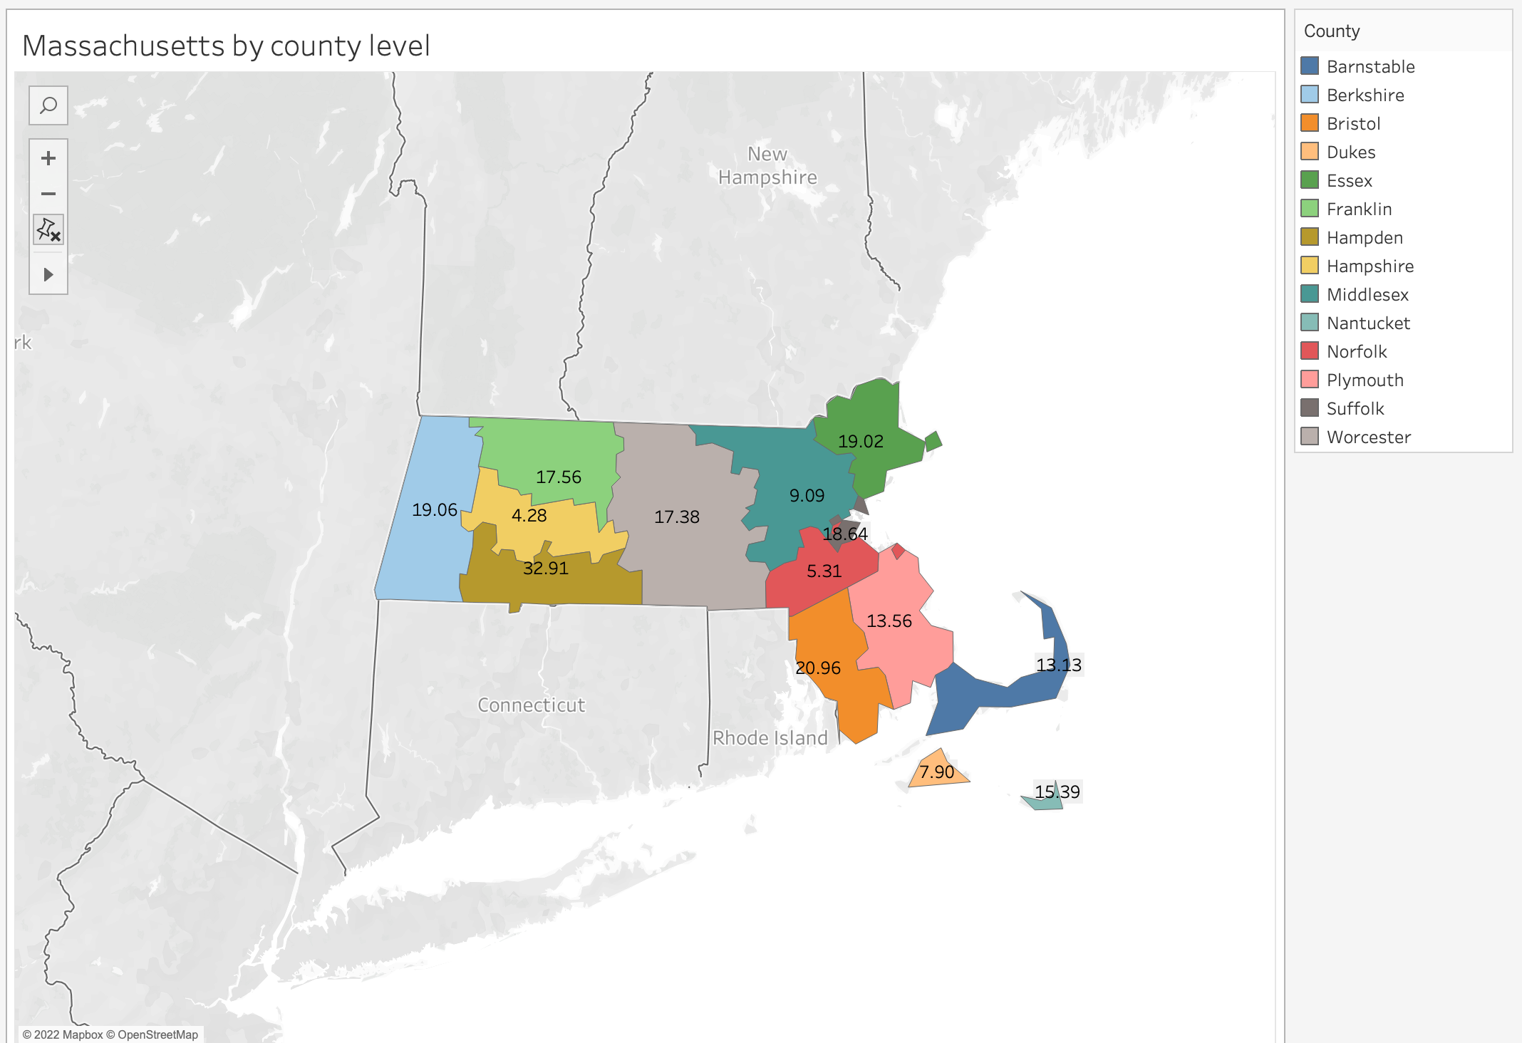
MASSACHUSSETTS
The teen birth rate in Massachusetts continued to decline in 2014, but the rates for Hispanic and black teenagers remained far higher than the those for whites and Asians.
The overall teen birth rate in Massachusetts in 2014 was 10.6 births per 1,000 girls and women ages 15-19, and 6.1 in 2020.
The county with the highest teen birth rate in Massachusetts from 2014-2020 was Hampden with a birth rate of 32.91 and Hampshire county coming at the bottom with a birth rate of 4.28.

Slide 15
Factors contributing to low teen birth rates in Massachusetts
-Increased availability of a wide range of contraceptives, including -highly effective long-acting reversible contraceptives (LARC); implementation of programs that include information on how to and where to obtain contraceptives.
-Youth development programs that work toward increasing protective factors and decreasing risk factors associated with teen pregnancy and targeting of resources in communities with the highest teen birth rates and other associated risk factors such as higher than average high school dropout rates, high rates of sexually transmitted infections (STI), and low-income levels.
-Teens receive sex education at an early age.
-The average age that a woman first gives birth is increasing
Source : https://www.aymag.com/cause-effect-teen-pregnancy-in-massachusetts/

Slide 16
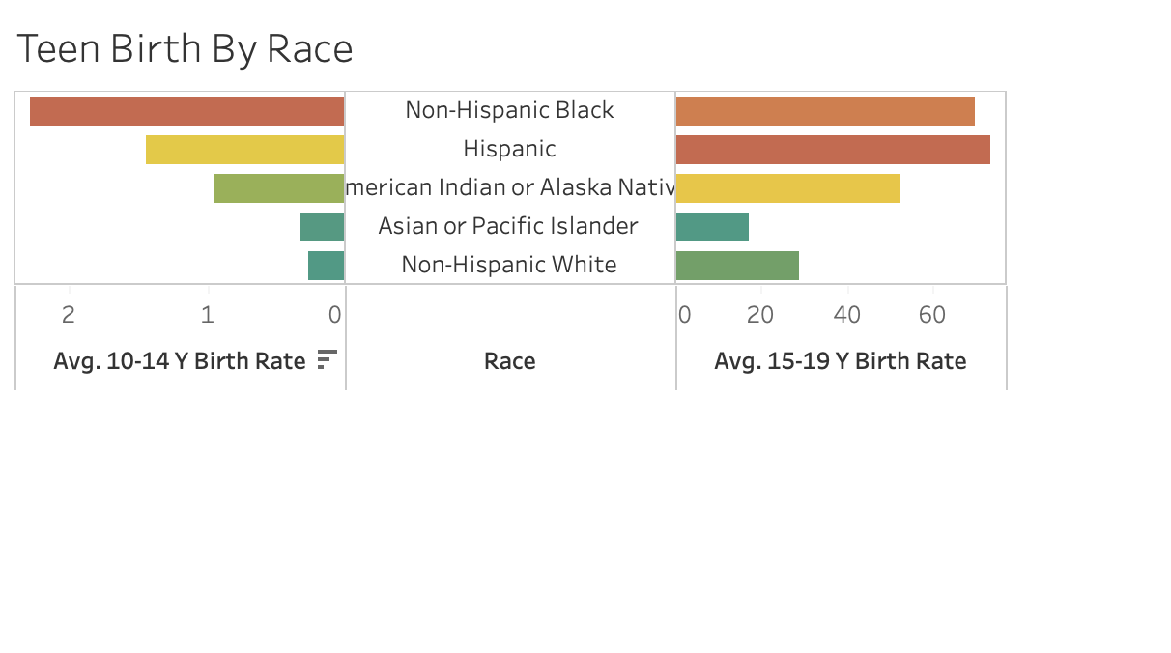
Teen Birth Rate by Race
Teen birth rates declined from 2014 to 2020 for several racial groups and for Hispanics. Among 15- to 19-year-olds, teen birth rates were:
73.42 for Hispanic females.
70.10 for non-Hispanic Black females.
52.34 for American Indian/Alaska Native
28.91 for non-Hispanic White females.
16.95 for Asian/Pacific Islander
Among 10- to 14-year-olds, teen birth rates
were:
1.437 for Hispanic females.
2.28 for non-Hispanic Black females.
0.947 for American Indian/Alaska Native
0.27 for non-Hispanic White females.
0.327 for Asian/Pacific Islander

Slide 17
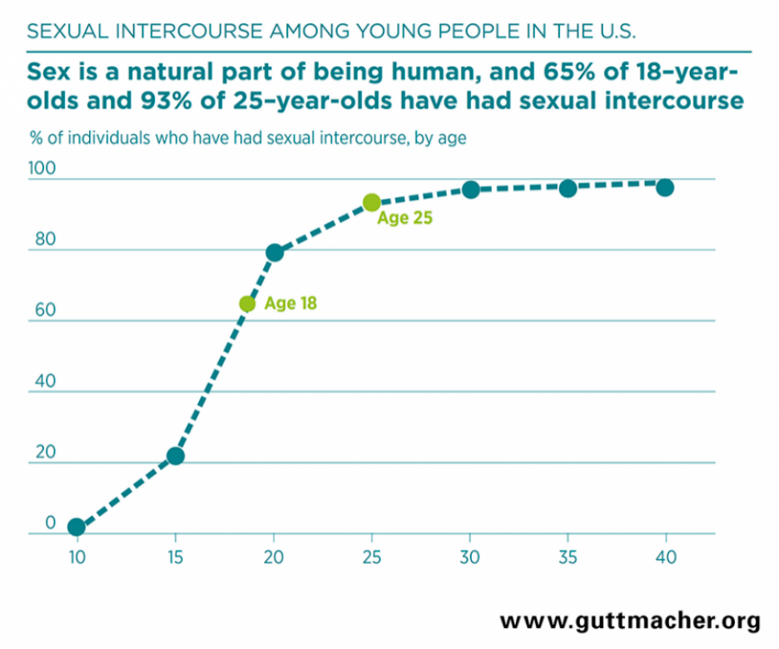
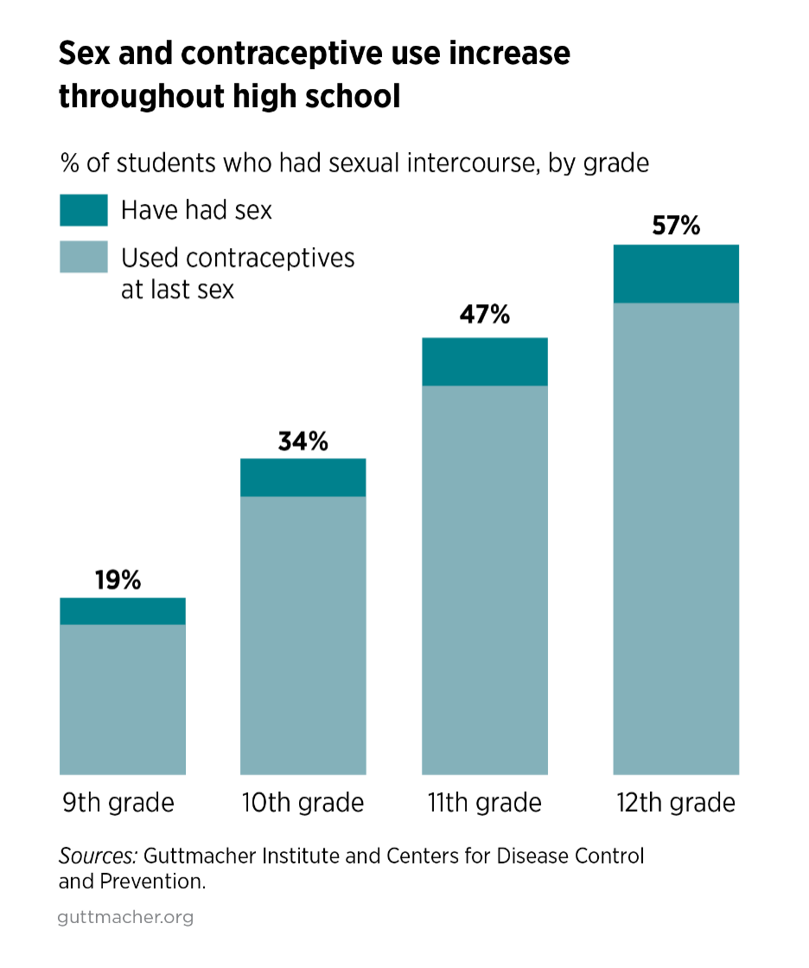

Slide 18
What can be done
-Encourage teens not to have sex. Parents/adults should not mandate it for children that they should abstain. Rather, they should have an open talk about sex.
-Discourage early dating.
-Offer a broad range of birth control options to teens, including Long-Acting Reversible Contraception (LARC), and discuss the pros and cons of each.
-Federal government should develop and evaluate programs in communities where teen births are highest.
-Comprehensive Sex education and reproductive health services should be offered to teens
If you do not feel comfortable talking with your parent or adult, call :-
The American Pregnancy Hotline (1-866-942-6466) ○
Planned Parenthood Federation of America (1-800-230-PLAN)
Teen Line (1-800-852-8336) is operated by teens

Slide 19
Summary
Preventing teen pregnancy is a priority because of the huge economic, social, and health costs on teen parents and their families.
Teen birth rates in the US are unacceptably high and up to 9 times higher compared to other developed countries.
About 4% of all teenage girls give birth each year. Teen births represent 10% of the 4 million births each year.
Hispanic and black teen girls are about 2-3 times more likely to give birth than white teen girls. Use of birth control is lower among sexually active black and Hispanic high school students than white students.
Girls born to teen parents are almost more likely to become teen parents themselves, continuing the cycle of teen pregnancy⁵.
About 50% of teen mothers get a high school diploma by age 22, compared with 90% of teen girls who do not give birth⁵.
Teen childbearing costs US taxpayers about $9 billion each year⁵.
⁵https://www.cdc.gov/teenpregnancy/about/social-determinants-disparities-teen-pregnancy.htm

Slide 20
Conclusion
There were several factors(better access to effective contraception, better access to sexual health information, less risk-taking behavior among teens, more intensive parental supervision, better understanding of consent, more sense of educational and economic opportunity, less autonomy among teens, even things like the rise of smartphones and the show “Teen Mom”. ) mentioned in the research project based on research-informed guesses with no raw data as to why teen birth rate was declining but the truth is that we don’t fully know why the teen birth rate is declining.
There seems to be a shift in teens deciding that they simply do not want to have babies and being able to support this intention.
There is still an urge on researchers to see if there was a large decrease in the total fertility rate for 2021 compared to 2020 because of Covid surges and if birth rates could tilt back up in 2022 and beyond.
The research does not stop here!

Slide 21
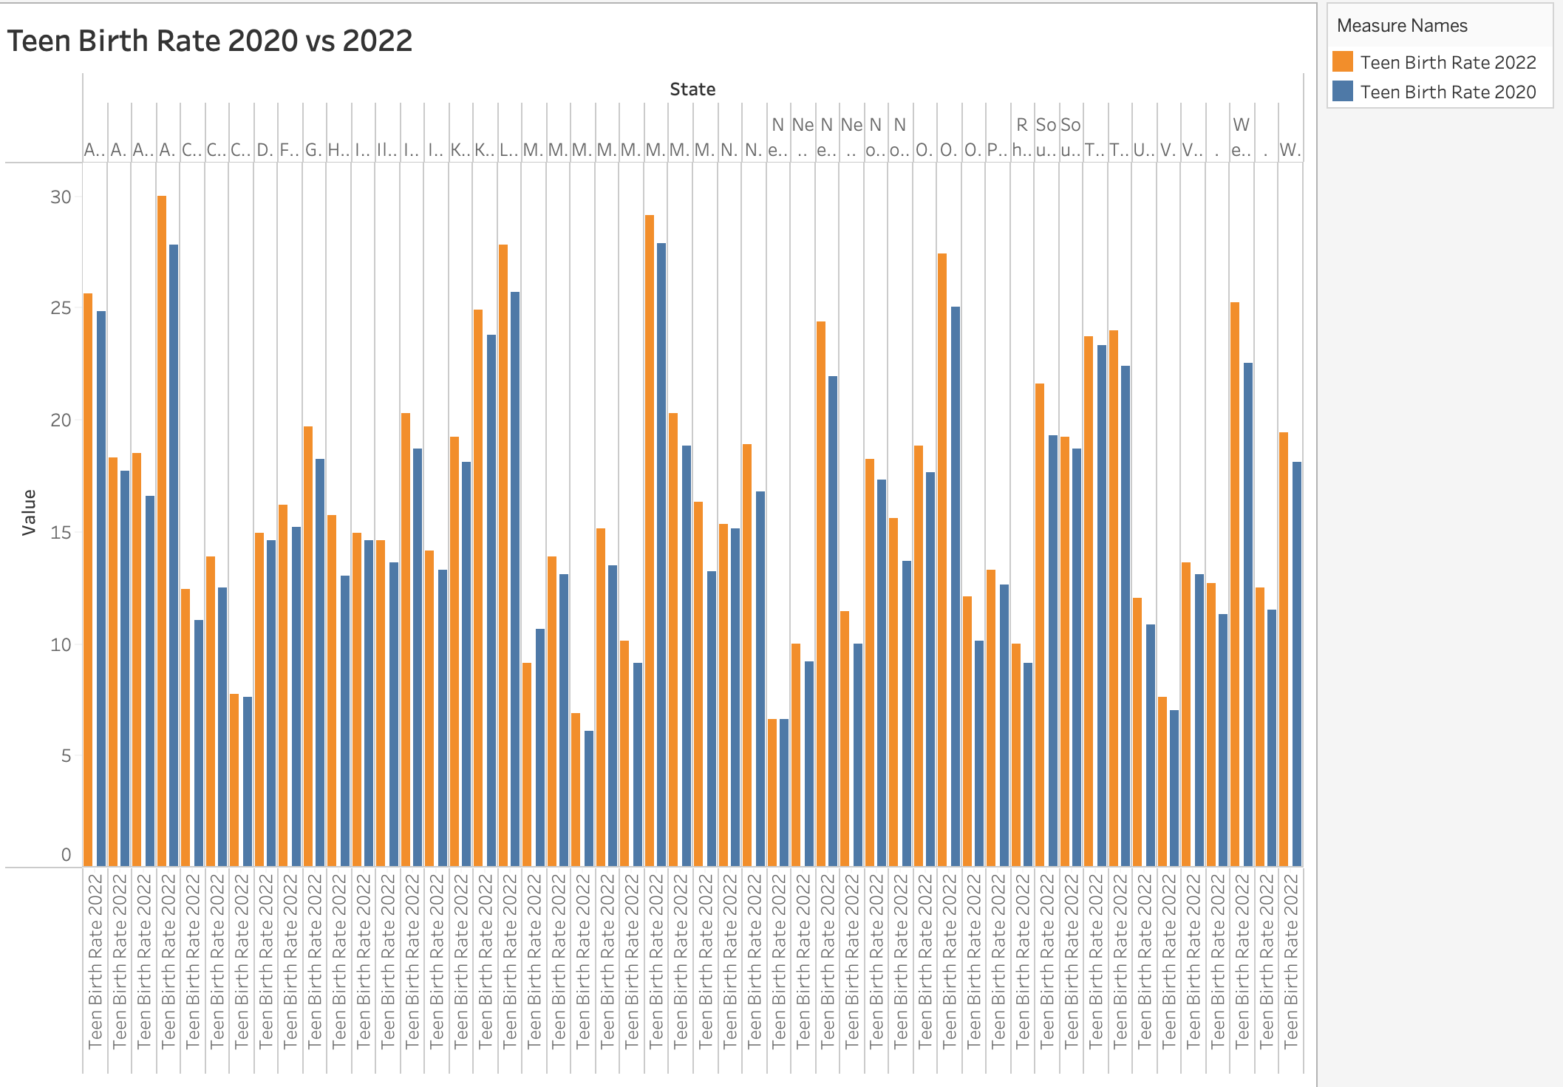

Slide 22

Code

Slide 23
QUESTIONS ???

Slide 24
Special Thanks
Joseph Raetano - Instructor
Matthew Gerardino – Mentor
Entity Academy Powered by Woz-U

